Slide 1
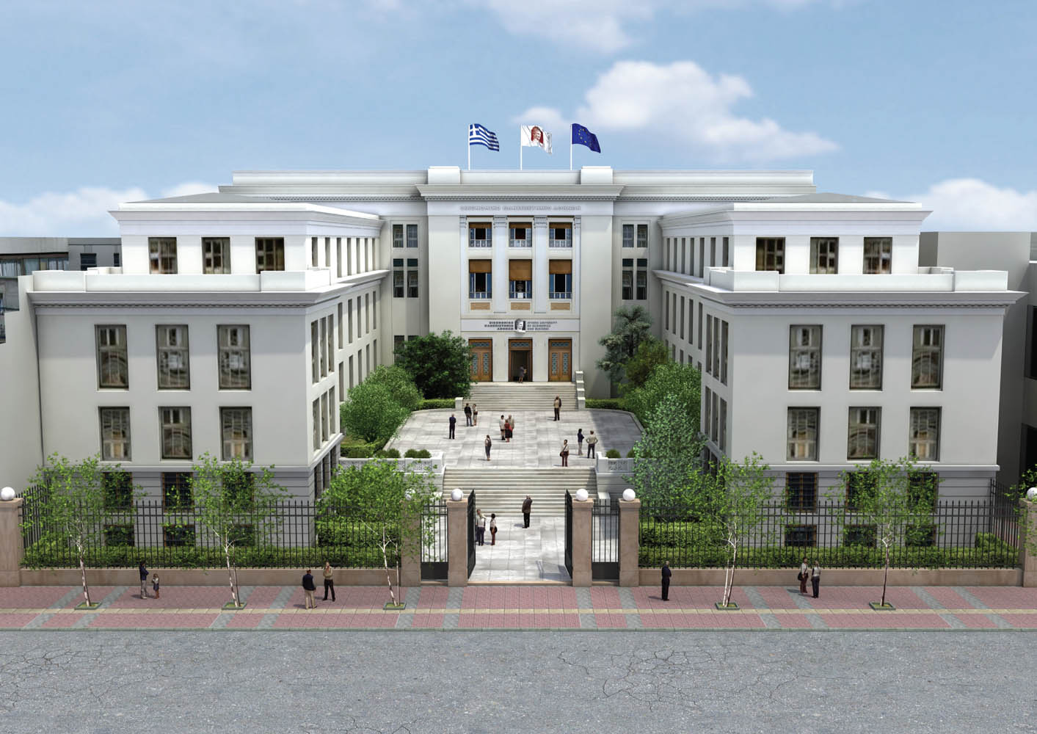
…………..
………………..

Slide 3
Thank you for your attention!

